Slide 1




PITCH DECK
Preço de aluguel em Nova York

Slide 2

Este conjunto de dados contém localização usando latitude e longitude, nomes de bairros, tipos de quartos, preços e algumas outras medidas de ocupação.
Canva
Powerpoint
Google Slides
Click on the "Canva" button under this preentation preview. Start editing your presentation. You need
to sign in to your
Canva account.
Export this design from Canva as a PowerPoint template. Open the design in Canva. This will provide you with all the fonts used and elements used in this presentation as listed on page 21. Learn more
on slide 3.
Export this design from Canva as a GoogleSlide template. This will provide you with all the fonts used and elements used in this presentation as listed on page 21. Learn more on slide 4.

Slide 3
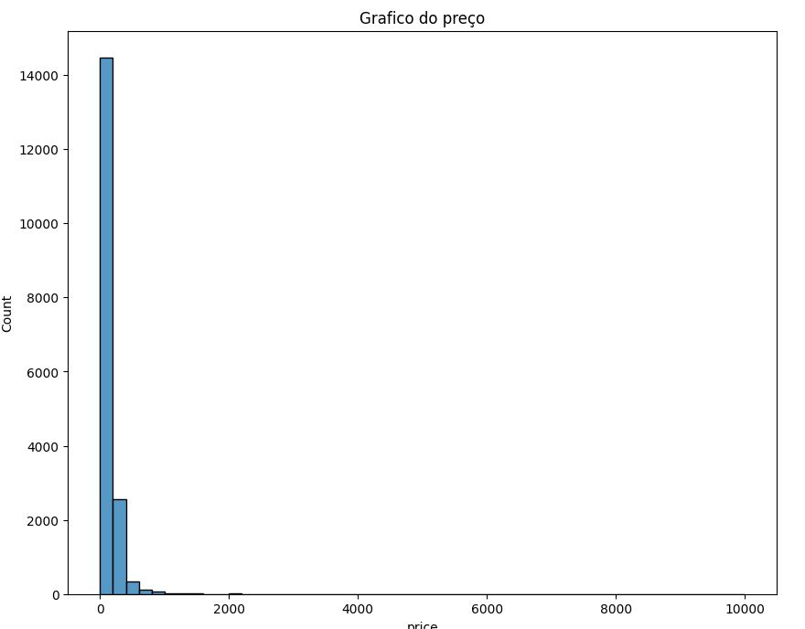

TABLE OF CONTENTS
01.
02.
03.
About Us
Our Projects
Stats & Numbers
Elaborate on what you want to discuss.
Elaborate on what you want to discuss.
Elaborate on what you want to discuss.

Slide 4
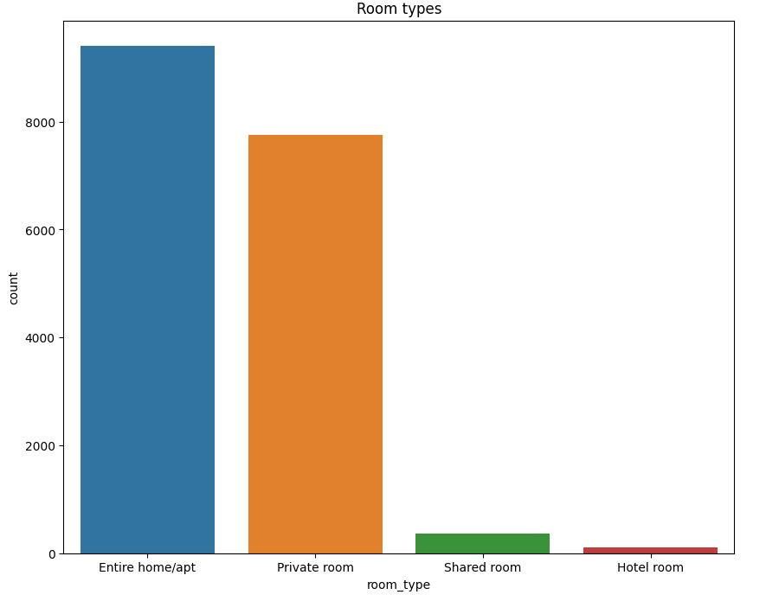
ABOUT US
01.
Elaborate on what you want to discuss.

Slide 5

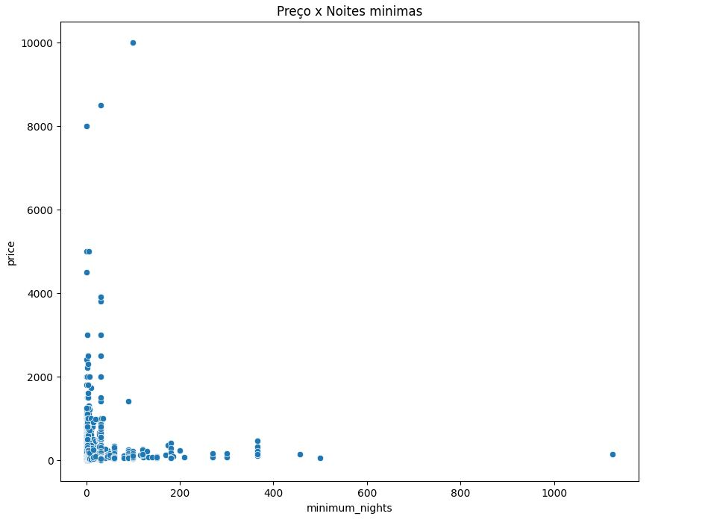
HELLO THERE!
I'm Raina, and I'll be sharing with you my beautiful ideas. Follow me a
@reallygreatsite to learn more.

Slide 6
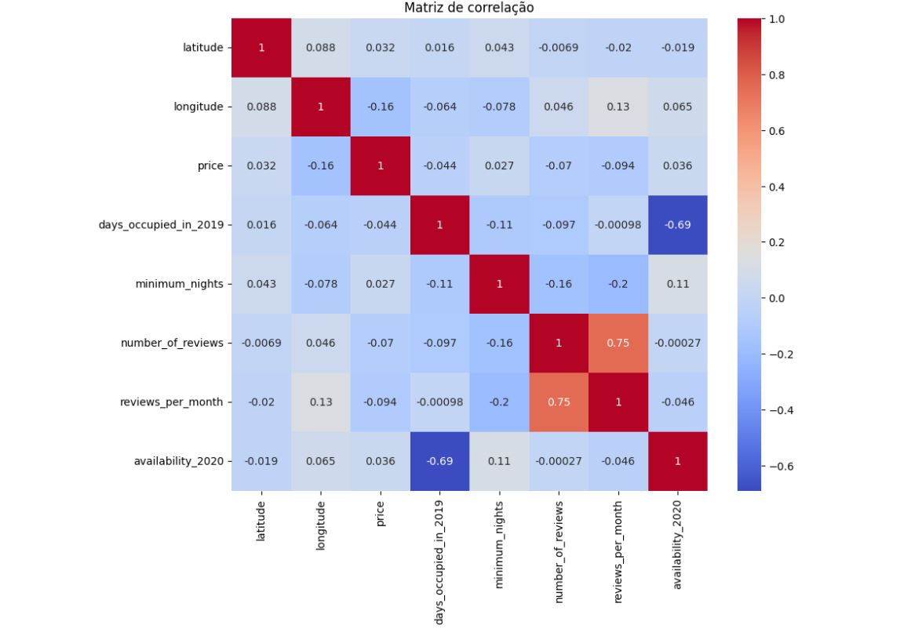
ABOUT US
What we do?
Who we are?
Briefly elaborate on what you want to discuss.
Briefly elaborate on what you want to discuss.

